Slide 1
BUTTERFLY PARK IN CHIKKANAKKUNDI
THANUSHREE.M , VAISHNAVI.M
CLASS 10

Slide 2
INTRODUCTION
Bangalore – 1000 lakes
Present – 80 lakes
Majestic- Dharmanbudi lake
LAKE 2022: Conservation of wetlands: ecosystem-based adaptation of climate change, December 28-30, 2022

Slide 3
CHIKKANAKKUNDI LAKE

Slide 4
NEED FOR THE STUDY
Developing village
Agriculture based village – 80%
Garbage menace
Apartments -sewage

Slide 5
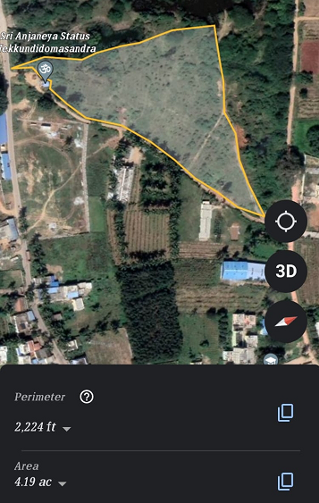
STUDY AREA

Slide 6
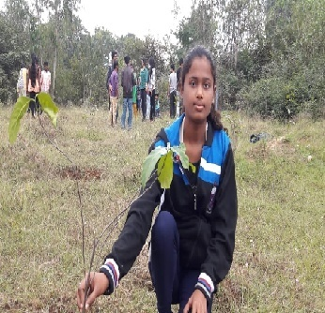
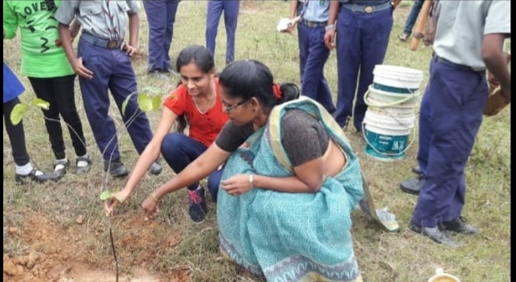
PLANTING
PHOTO

Slide 7
OBJECTIVE
To conserve the lake
Create a butterfly park
Awareness

Slide 8
OUR CONTRIBUTION

Slide 9
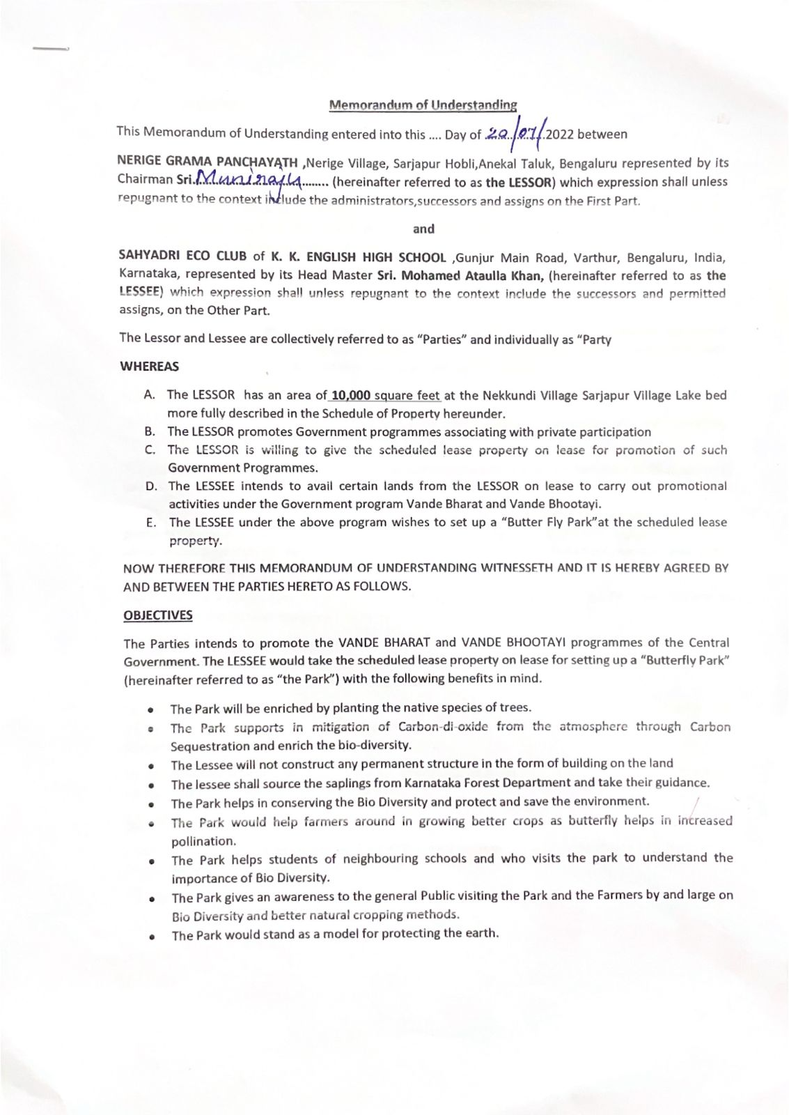

Slide 10
REMOVAL OF LANTANA

Slide 11
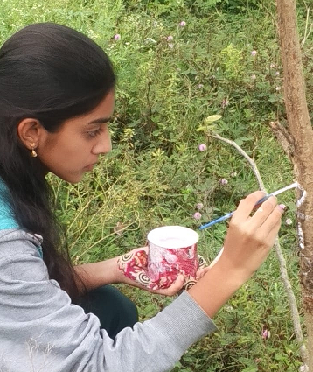
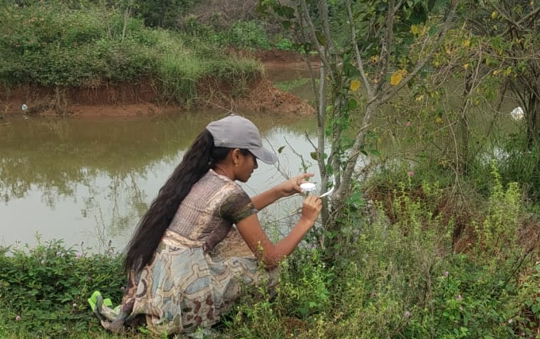
NUMBERING

Slide 12
PLANTS IN OUR STUDY AREA
Sl no | Scientific name | Common name | Family | No of trees
1 | Pongamia pinnata | Pongamia | Leguminosae | 249
2 | Ficus racemosa | Cluster Fig | Moraceae | 5
3 | Ficus religiosa | Sacred Fig | Moraceae | 1
4 | Psidium guajava | Guava | Myrtaceae | 4
5 | Vitex glabrata | Vitex | Lamiaceae | 2
6 | Maclura pomifera | Tennis ball fruit tree | Moraceae | 1
7 | Tectona grandis | Teak Wood | Verbenaceae | 1
8 | Shygisium cumini | Jamun | Myrtaceae | 6
 | SCIENTIFIC NAME | TOTAL.NO
1 | milltt | 249
2 | Cluster fig | 5
3 | Sacred fig | NAME
 |  | Pongamia
 |  | Ficus racemosa
 |  | Ficus religiosa
4 | Psidium guajava | Guava
5 | Vitex glabrata | Vitex glabrata
6 |  | Herbarium jcb
7 | Tectona grandis | Teak wood
8 | Tamarindus indica | Tamarind
9 | Shygisium cumini | Jamun
10 | rader machera | Rader machera Sinica
11 |  | Caturro Coliunbiano
12 | gmelina arborea | Gmelina arborea

Slide 13
9 | Rader machera sinica | Rader machera | Bignonaceae | 1
10 | Gmelina arborea | Gmelina | Lameaceae | 1
11 | Tamarindus indica | Tamarind | Fabaceae | 2

Slide 14
PLANTING PROGRAM
Curry leaf plants=64
Neem =3
Hibiscus =1

Slide 15
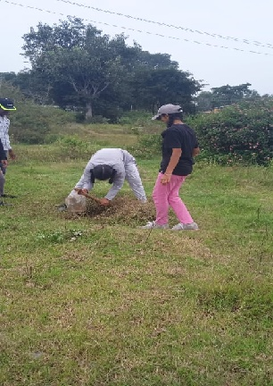

Slide 16
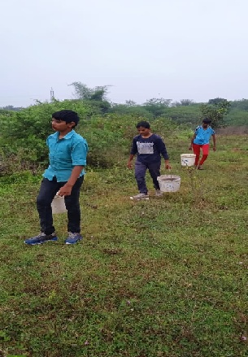

Slide 17
PERMISSION LETTER FROM THE PANCHAYATH

Slide 18
RECOMMENDATIONS
Butterfly host plants
Fencing the park
De-weeding
Awareness programme
Lake protection committee

Slide 19
BUTTERFLIES IN OUR STUDY AREA
Name | Host plant
Blue Mormon | Curry leaf, citrus sps.
Common Castor | Castor
Common Rose | Aristolochia sps.
Crimson Rose | Lantana
Common Grass Yellow | Caesalpinia sps.
Common Cerulean | Pongamia
Common Indian Crow | Pongamia
Common bush brown | Grass
Plain Tiger | Milkweed
Common Emigrant | Cassia alata
Dark blue tiger | Asclepias

Slide 20
CONCLUSION
The present lake bed (allotted area of 10,000sq.ft)
Butterfly park
Biological park

Slide 21
REFERENCE
Butterfly chart- EYES ON NATURE
Book on Butterflies

Slide 22
WE SHOULD BE SOFT, DOWN TO EARTH, SENSIBLE LIKE EGG
WORK LIKE PUPA SILENTLY
EAT LIKE CATTERPILLAR
ONLY THEN WE CAN BECOME A SENSIBLE HUMAN BEING

Slide 23
THANK YOU

